Slide 1

Digital + Social + Mobile

Slide 2
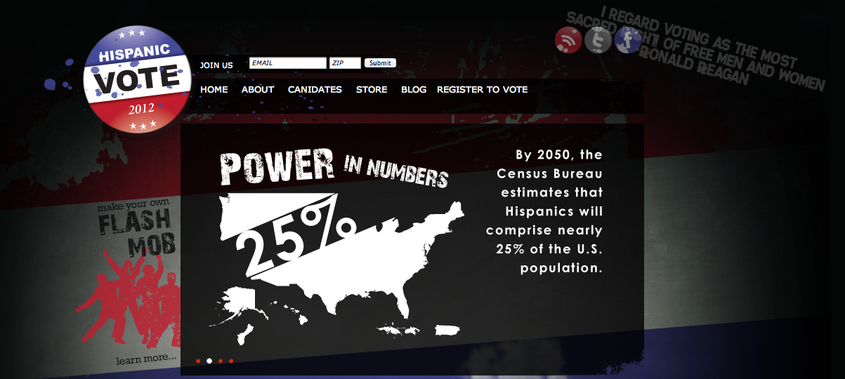



Toolbar >> Passive Revenue & Engagement
Streaming Video >> Passive Revenue, Content & Engagement
SMS >> Passive Revenue & Engagement

Slide 3
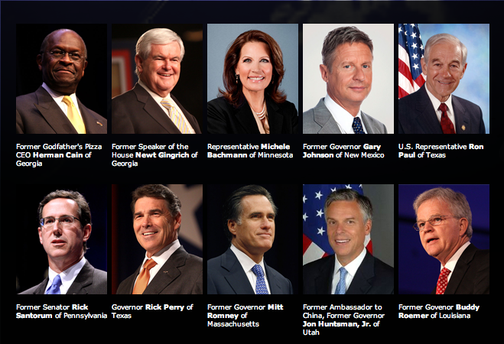
Distribution >> Content & Distribution Partnerships

Slide 4
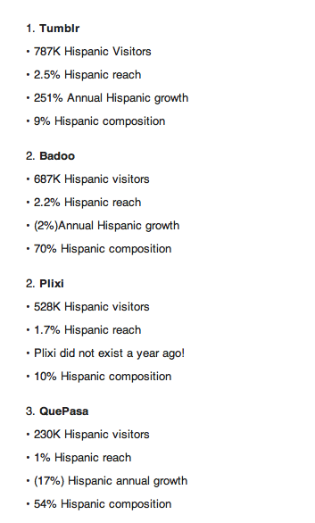
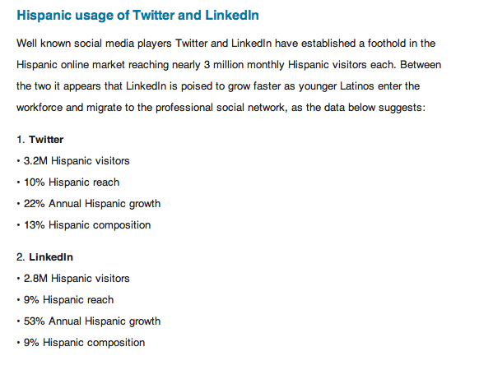
Distribution>> Partnerships

Slide 5
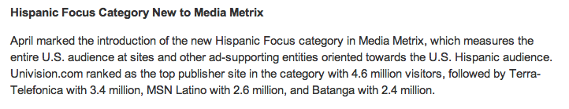
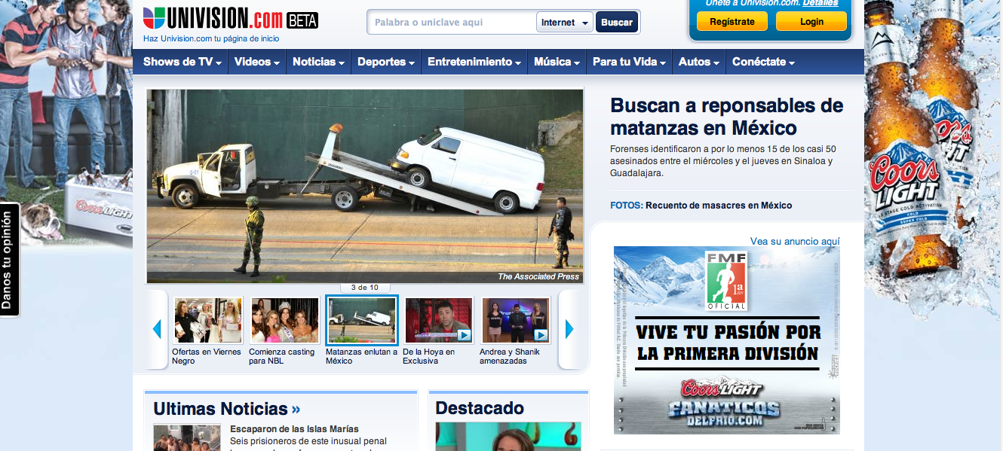
Media>> Engagement & Traffic to Site / Content

Slide 6
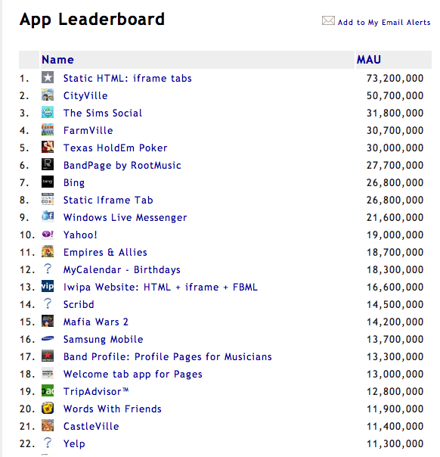
Social>> Engagement & Audience Building

Slide 7
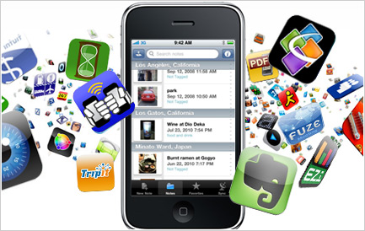
Mobile>> Distribution & Engagement

Slide 8
Strategic Overview
Social, Digital & Mobile
Develop content for engagement & growing audience across platforms
Monetize through direct call to action (donations, micro transactions)
Monetize through B2B partnerships (advertising & partnerships)
Media Planning
Media spend with partners to grow audience
Audience growth = monetization
Focus on ROI for media arbitrage
Audience Growth
Awareness of vote, power of the Hispanic vote, engage the audience

Slide 9
Long Term Strategy
Become destination for Hispanic content
Streaming video channel / network
Political & related content
Own the audience
Opt-in database for direct and indirect monetization
Audience Growth
Awareness of vote, power of the Hispanic vote, engage the audience

Slide 10
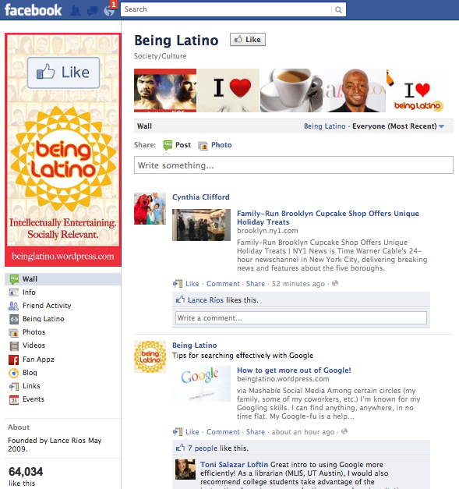
Next Steps
Build out Facebook Page
Graphics
Content
Goal
Preparation for CPAC
Become top “liked” Hispanic fan page in next 6 months

Slide 11
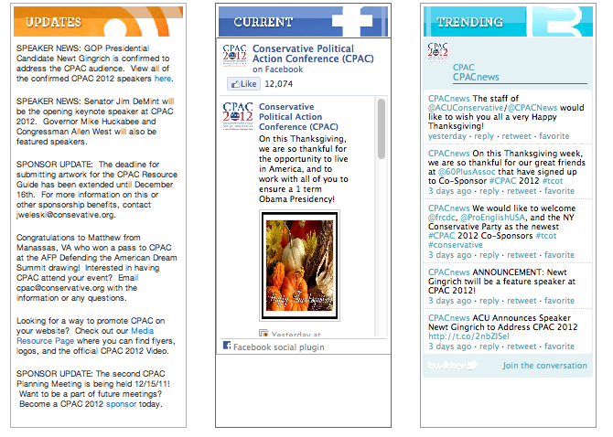
Next Steps
Blogger Contest
Promote contest for full time blogging position
Winner gets scholarship
Voted on by “crowd”
Winner selected by Super Committee from top votes (Dennis & Laura)
Announce winner at CPAC in Feb 2012
Goal
Trending on twitter during event

Slide 12

Next Steps
CPAC
Mobile App for launch at CPAC
App is basic with engagement
Signage at event to promote the App
Contest for downloading the App
SCAVNGR
Scavengr hunt at event tied to speaking / presentation event
More engagement tied to Facebook & Mobile / Social Strategy
Goal is 2,000 registrants for both APP and SCAVNGR
ROI is audience growth for monetization against content development

Slide 13

More than We Can Imagine
Platforms
Toolbars
Mobile
SMS
Social
Streaming video
Media Planning
Distribution
Traffic
Monetization
B2C & B2B revenues to grow the media campaigns, platforms, content &audience
Awareness
Power of the movement

Slide 14
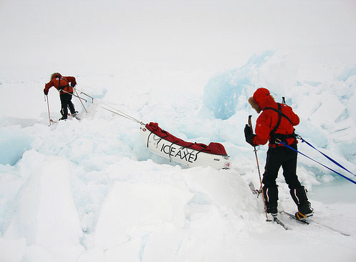
Hispanicvote.com
The Journey Begins

